Slide 1
Question Answering
Answer Types and Query Formulation

Slide 2
Factoid Q/A

Slide 3
Question Processing Things to extract from the question
Answer Type Detection
Decide the named entity type (person, place) of the answer
Query Formulation
Choose query keywords for the IR system
Question Type classification
Is this a definition question, a math question, a list question?
Focus Detection
Find the question words that are replaced by the answer
Relation Extraction
Find relations between entities in the question

Slide 4
Question Processing They’re the two states you could be reentering if you’re crossing Florida’s northern border
Answer Type: US state
Query: two states, border, Florida, north
Focus: the two states
Relations: borders(Florida, ?x, north)

Slide 5
Answer Type Detection: Named Entities
Who founded Virgin Airlines?
PERSON
What Canadian city has the largest population?
CITY.

Slide 6
Answer Type Taxonomy
Xin Li, Dan Roth. 2002. Learning Question Classifiers. COLING'02
6 coarse classes
ABBEVIATION, ENTITY, DESCRIPTION, HUMAN, LOCATION, NUMERIC
50 finer classes
LOCATION: city, country, mountain…
HUMAN: group, individual, title, description
ENTITY: animal, body, color, currency…

Slide 7
Part of Li & Roth’s Answer Type Taxonomy

Slide 8
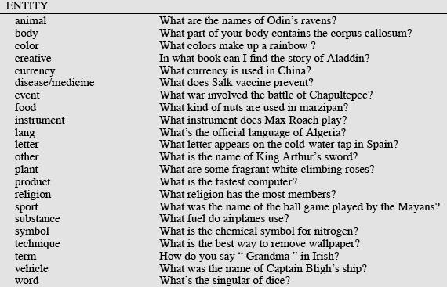
Answer Types

Slide 9
More Answer Types

Slide 10
Answer types in Jeopardy
Ferrucci et al. 2010. Building Watson: An Overview of the DeepQA Project. AI Magazine. Fall 2010. 59-79.
2500 answer types in 20,000 Jeopardy question sample
The most frequent 200 answer types cover < 50% of data
The 40 most frequent Jeopardy answer types
he, country, city, man, film, state, she, author, group, here, company, president, capital, star, novel, character, woman, river, island, king, song, part, series, sport, singer, actor, play, team, show, actress, animal, presidential, composer, musical, nation, book, title, leader, game

Slide 11
Answer Type Detection
Hand-written rules
Machine Learning
Hybrids

Slide 12
Answer Type Detection
Regular expression-based rules can get some cases:
Who {is|was|are|were} PERSON
PERSON (YEAR – YEAR)
Other rules use the question headword:
(the headword of the first noun phrase after the wh-word)
Which city in China has the largest number of foreign financial companies?
What is the state flower of California?

Slide 13
Answer Type Detection
Most often, we treat the problem as machine learning classification
Define a taxonomy of question types
Annotate training data for each question type
Train classifiers for each question class using a rich set of features.
features include those hand-written rules!

Slide 14
Features for Answer Type Detection
Question words and phrases
Part-of-speech tags
Parse features (headwords)
Named Entities
Semantically related words

Slide 15
Factoid Q/A

Slide 16
Keyword Selection Algorithm
Dan Moldovan, Sanda Harabagiu, Marius Paca, Rada Mihalcea, Richard Goodrum, Roxana Girju and Vasile Rus. 1999. Proceedings of TREC-8.
1. Select all non-stop words in quotations
2. Select all NNP words in recognized named entities
3. Select all complex nominals with their adjectival modifiers
4. Select all other complex nominals
5. Select all nouns with their adjectival modifiers
6. Select all other nouns
7. Select all verbs
8. Select all adverbs
9. Select the QFW word (skipped in all previous steps)
10. Select all other words

Slide 17
Choosing keywords from the query
Slide from Mihai Surdeanu
Who coined the term “cyberspace” in his novel “Neuromancer”?
1
1
4
4
7
cyberspace/1 Neuromancer/1 term/4 novel/4 coined/7

Slide 18
Question Answering
Answer Types and Query Formulation

